Slide 1






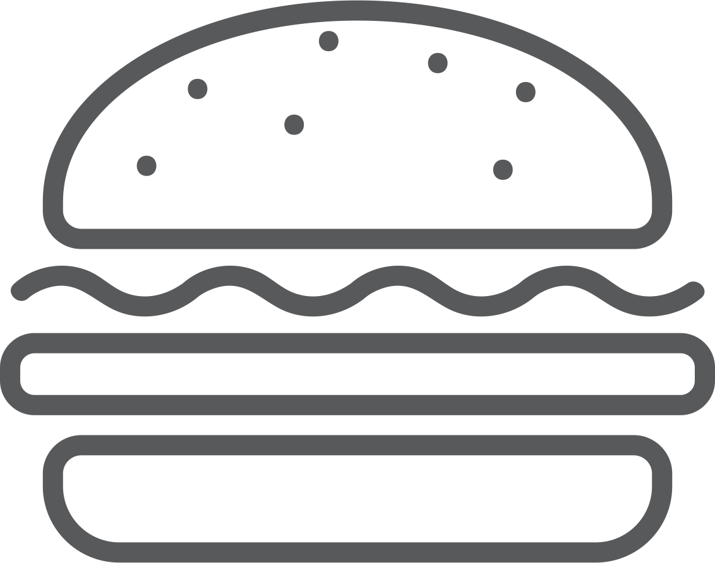

Zomato Restaurants Analysis
Data Analytics With R

Slide 2




Table of Contents
1. Business Problem
2. Loading Packages
3. Preprocessing Data
4. Basic Exploration
5. Favorite Cuisine
6. What effects ratings
7. Must Visit in Delhi
8. Summary

Slide 3

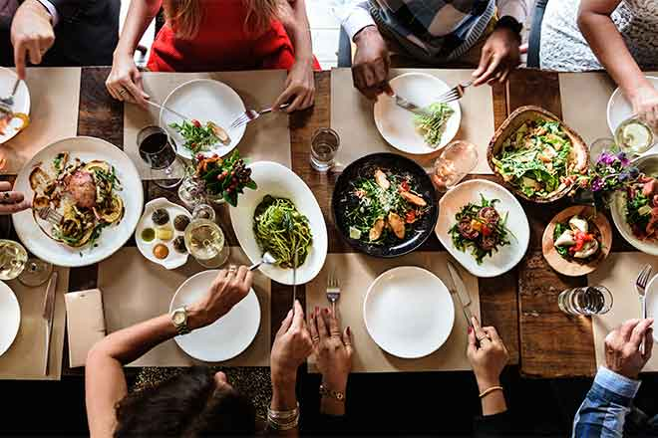

Business Problem

Slide 4
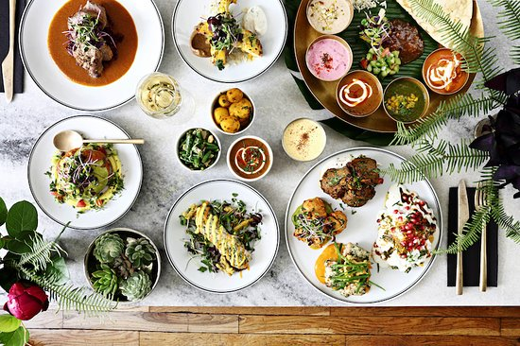
Where should you eat! What you should eat! Will it be good!
These are the questions always on mind not just when you are travelling but also in day to day life. No one wants a bad experience. Everyone wants to eat the most popular dish of a place and at the best restaurant and at a reasonable rate. But HOW??

Slide 5
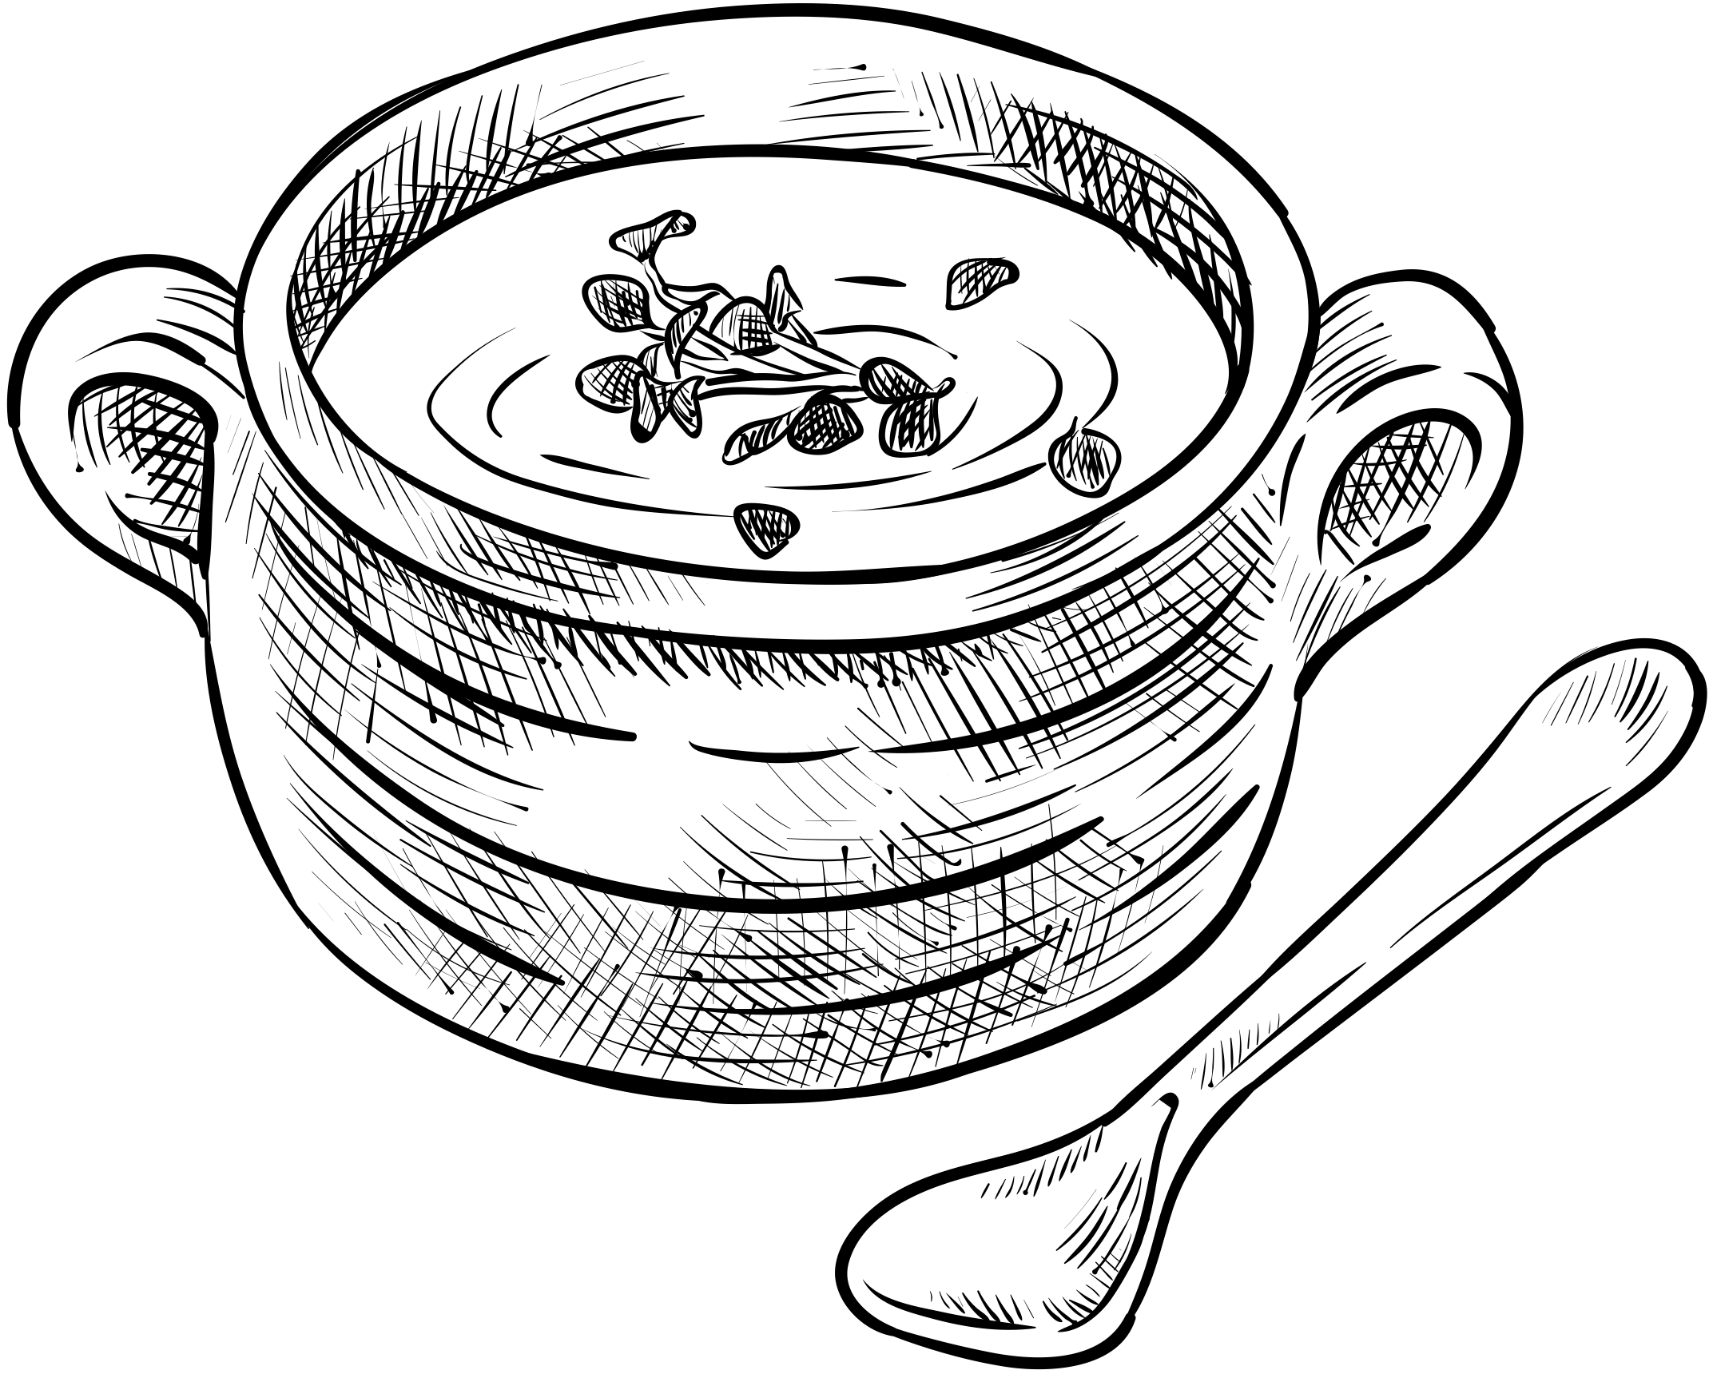
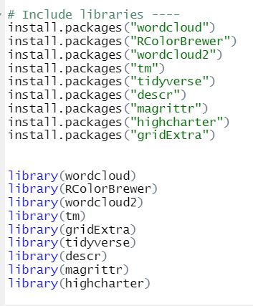


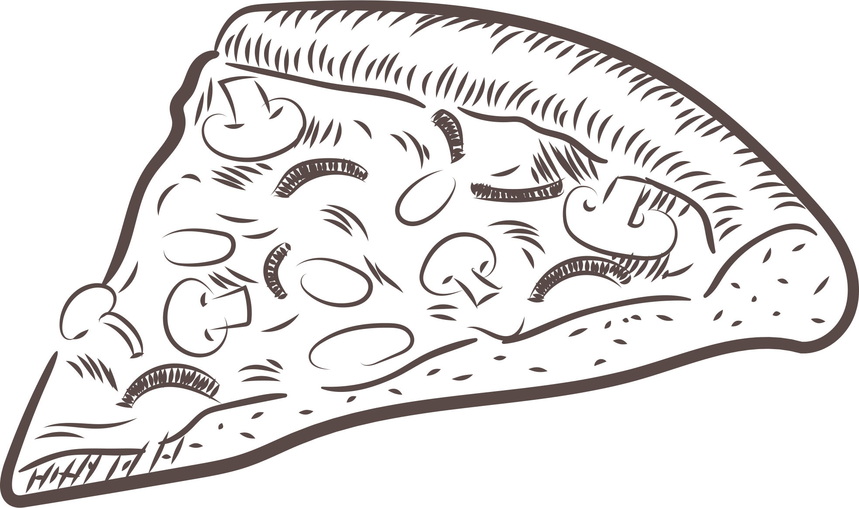
Loading Packages & Data File
Packages that are needed for visualizations are installed followed by storing data in keyword "Zomato"

Slide 6
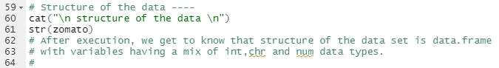
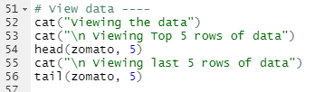
Preprocessing Data
Dataset has 8652 observations & 21 variables
Dataset is of "Data Frame" type

Slide 7
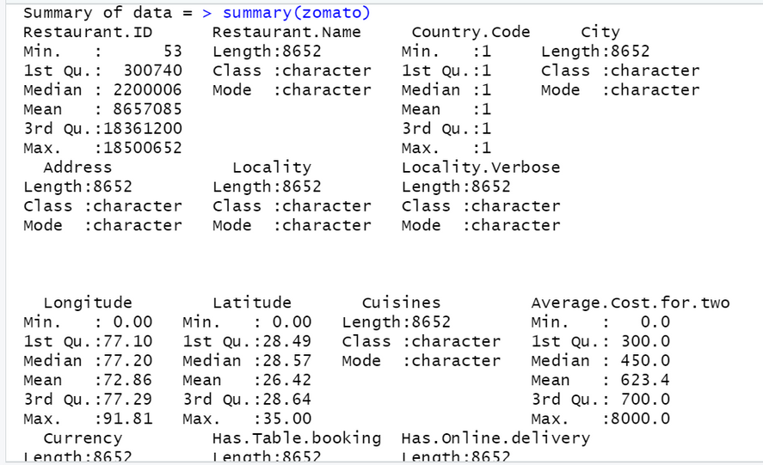
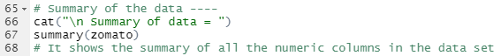
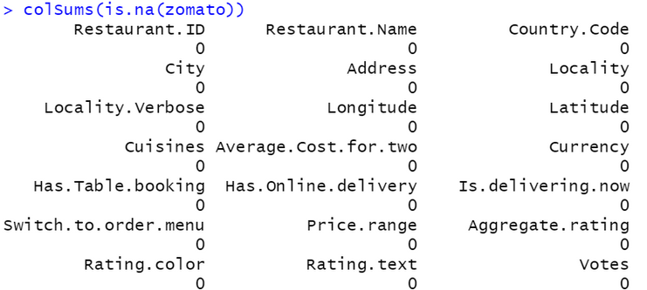

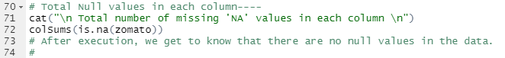
Preprocessing Data
Dataset has no null values

Slide 8
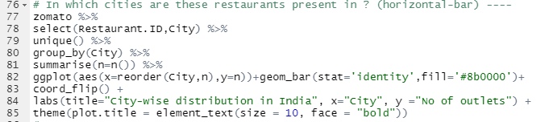
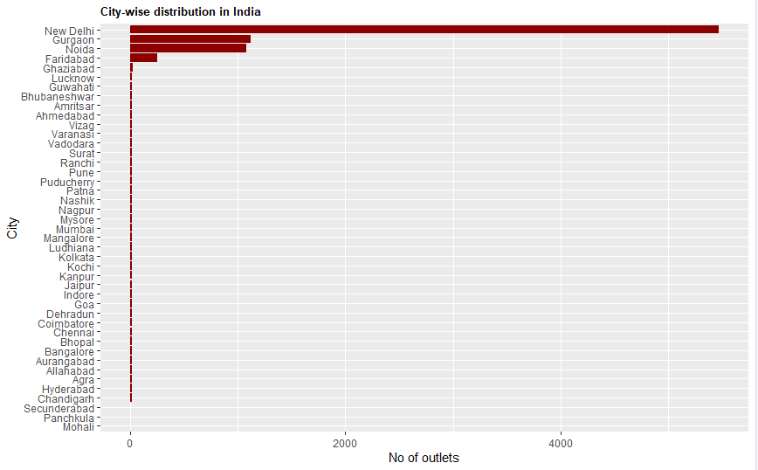
Which all cities are present in dataset?
City wise distribution of restaurants
A lot of restaurants in the dataset are located in Delhi, NCR, Noida. There are a high chances that the dataset is biased

Slide 9
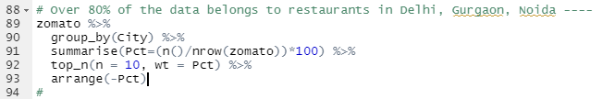
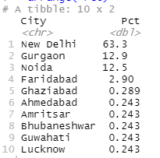

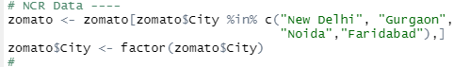
Is the data biased?
Nearly 85% of the restaurants in the dataset are located in New Delhi, Gurgaon, Noida and Faridabad (NCR). So we would only be going ahead with 4 cities

Slide 10
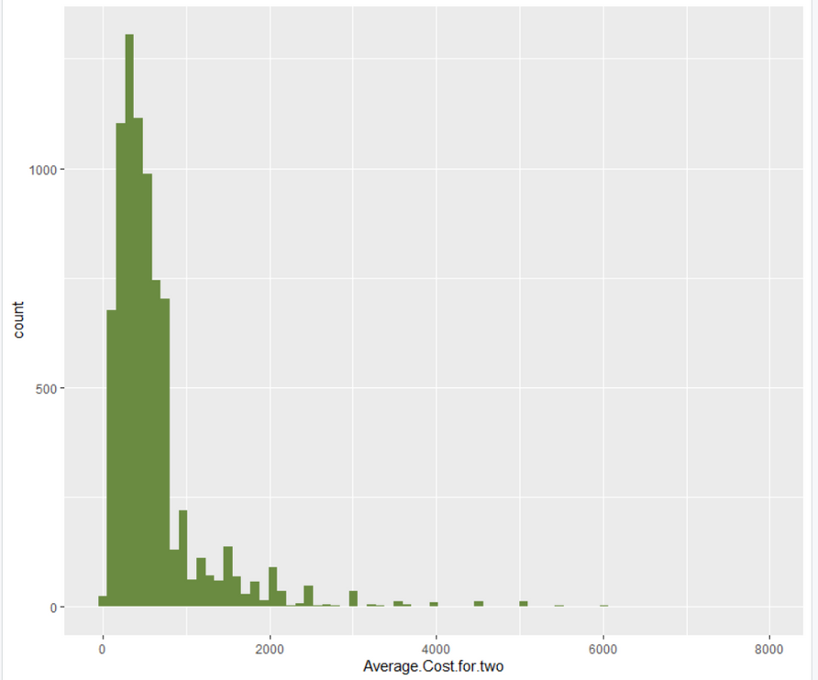
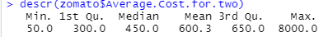
What is the average cost for 2 people?
The average cost for two in Delhi NCR is INR 600, however the highest cost for two is INR 8000.
Another factor to notice is you can feed yourself in INR 50 also in the region.

Slide 11
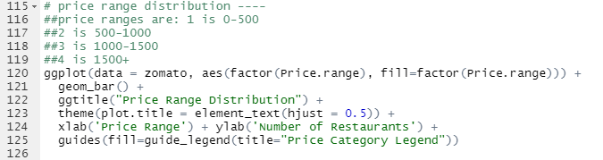
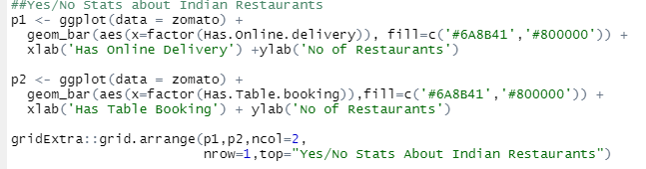
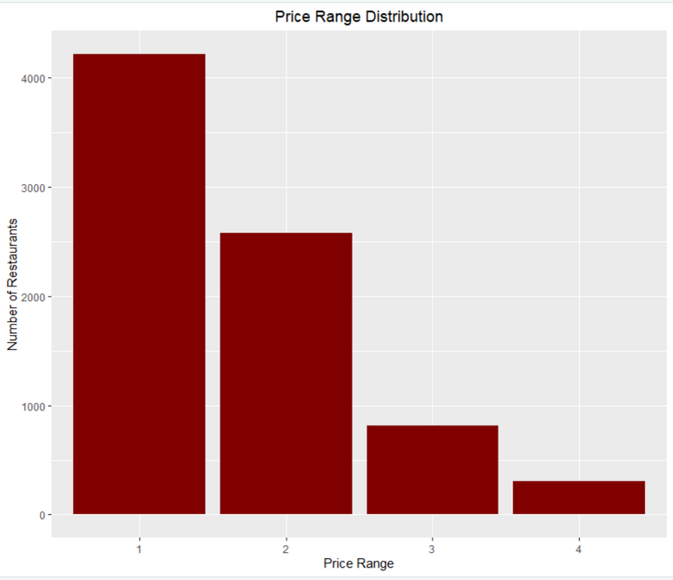
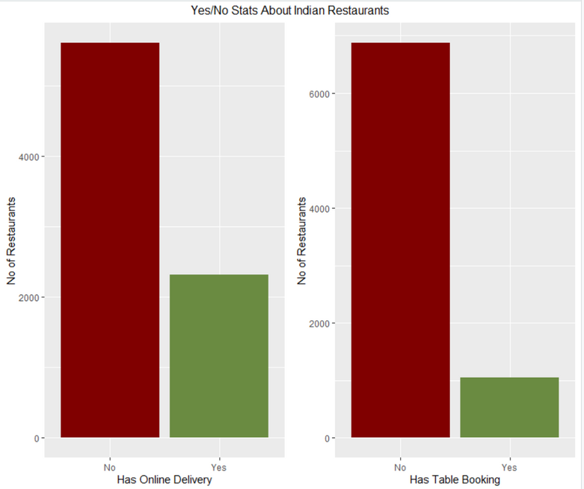
Price Range & Services Offered
4000+ restaurants are below the range of INR 500, which is less than the average cost for two. More than 4000 restaurants don't have online delivery & table booking service

Slide 12
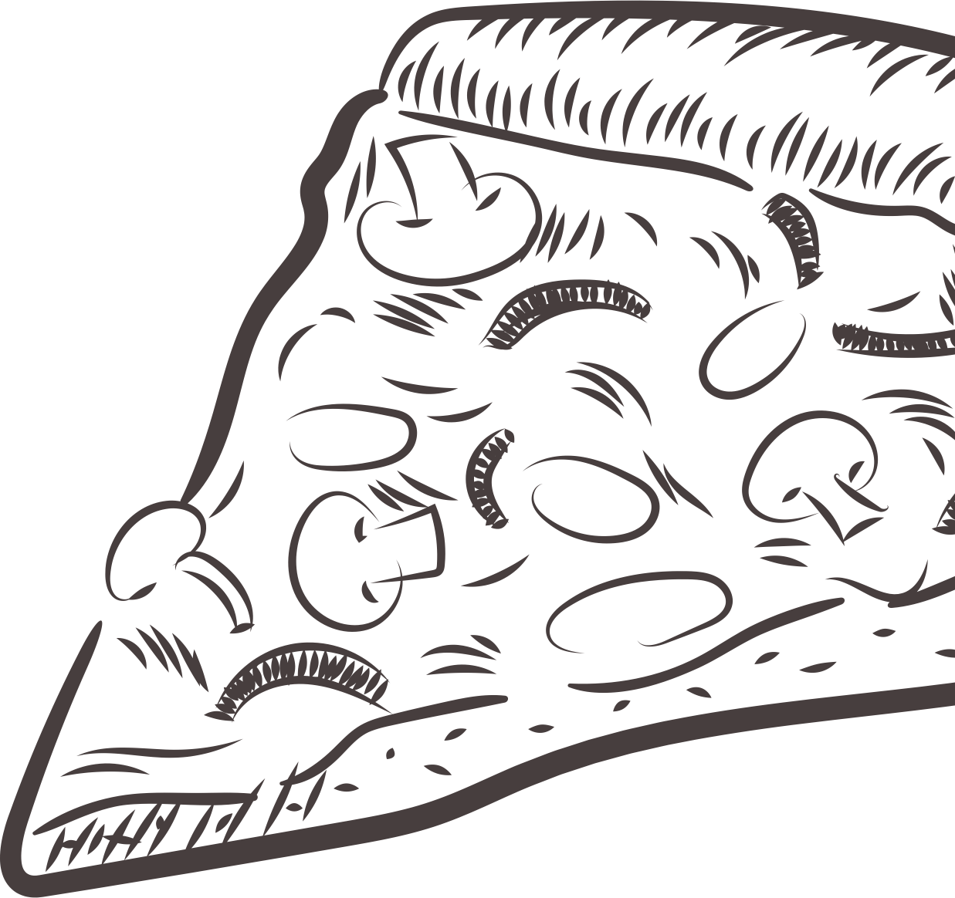
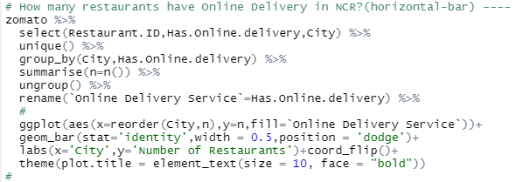
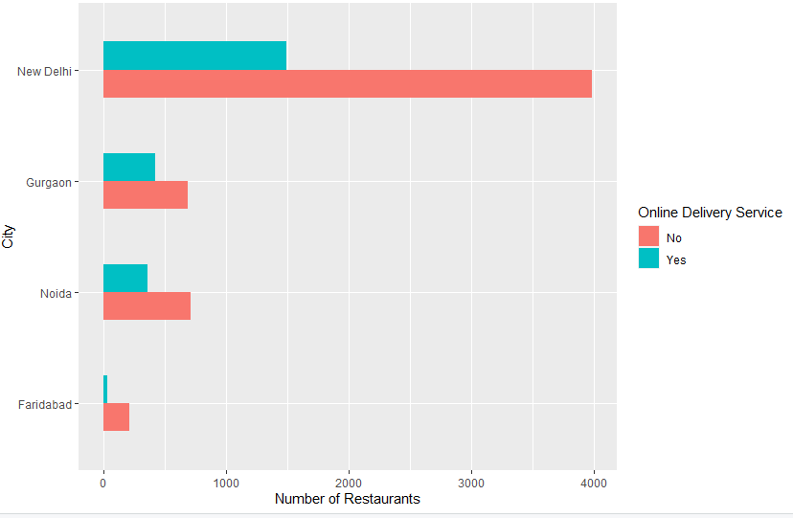
City Wise Online Delivery Service
Among the four cities, there are countable restaurants that offer delivery in Faridabad. Also, only Delhi has more than 1000 restaurants doing online delivery

Slide 13
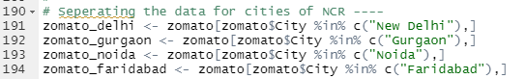


City Wise Data Segregation
Segregating the data
city - wise for further
granular analysis
Move forward
for popular cuisines

Slide 14

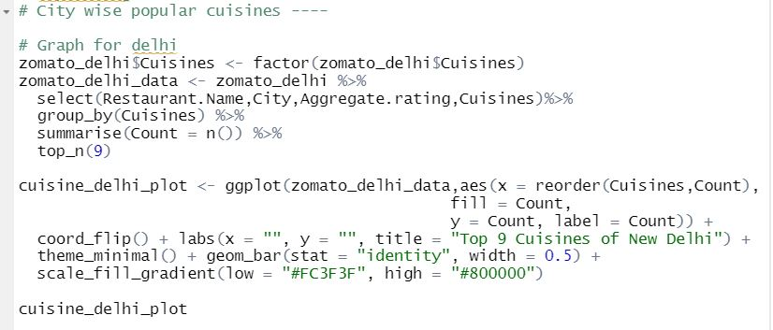
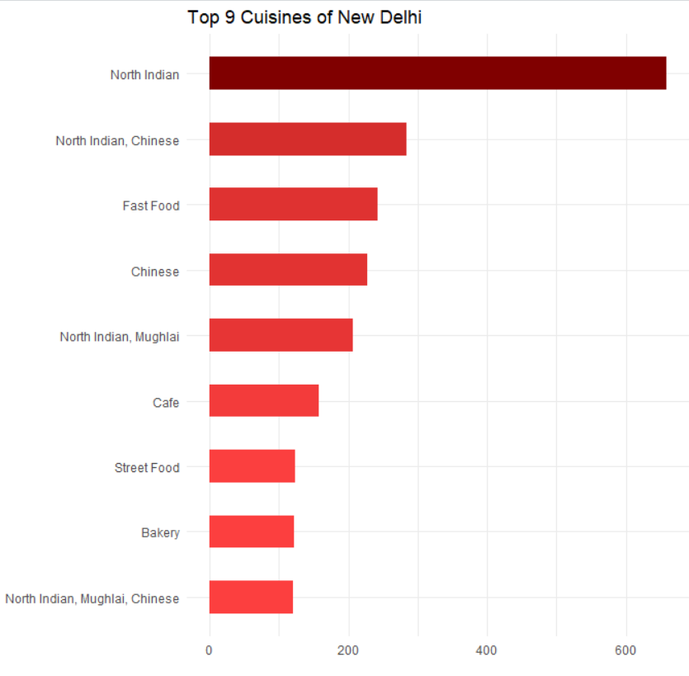
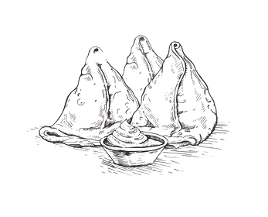

Delhi ka Zaika
Delhi people love "North Indian" cuisine with next favorite as "Chinese"

Slide 15
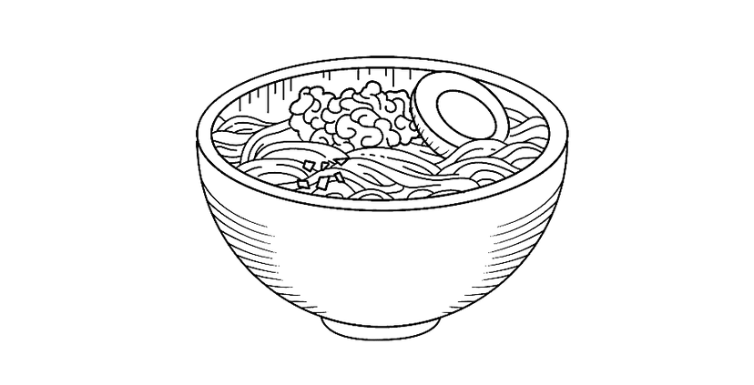
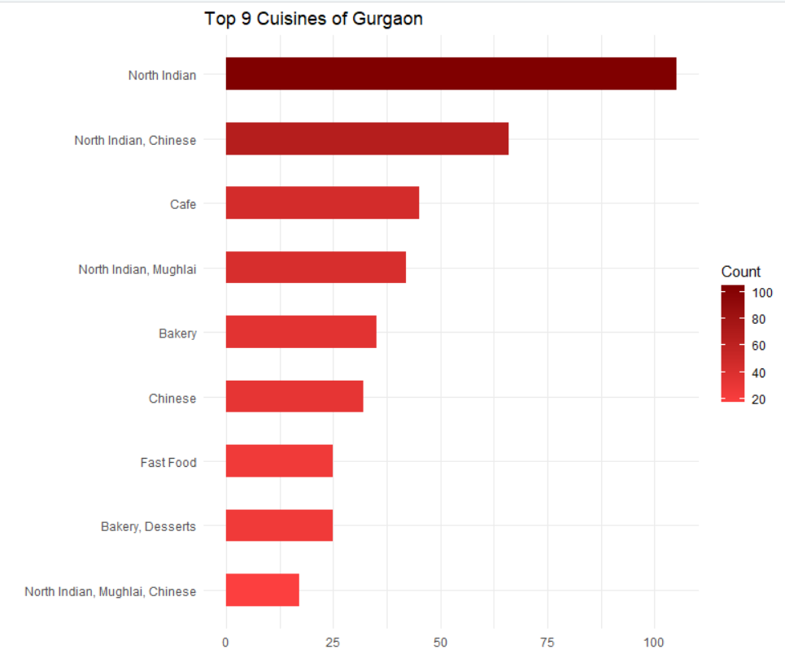
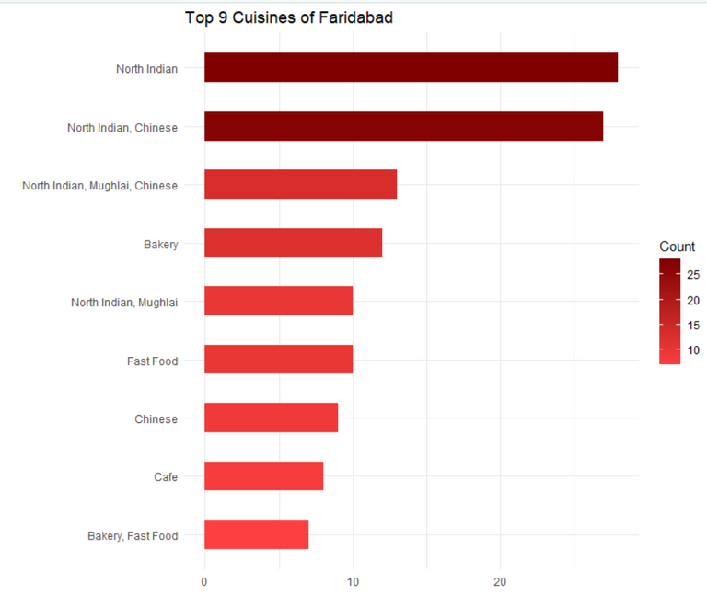
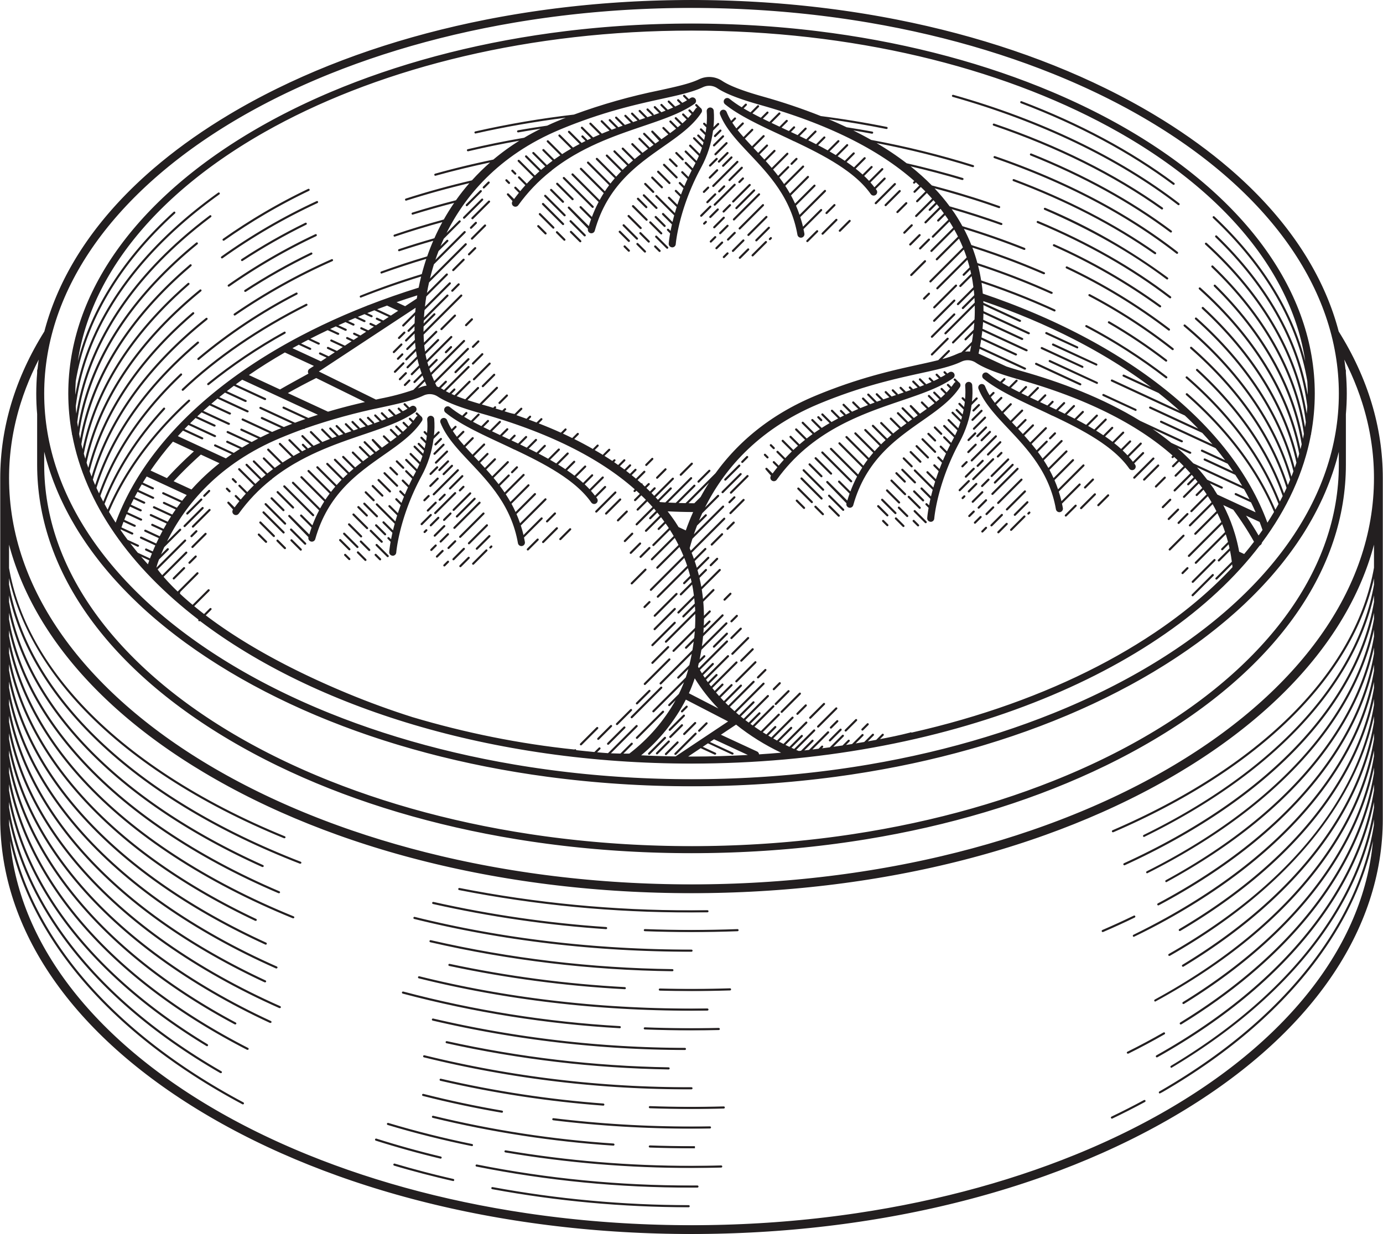
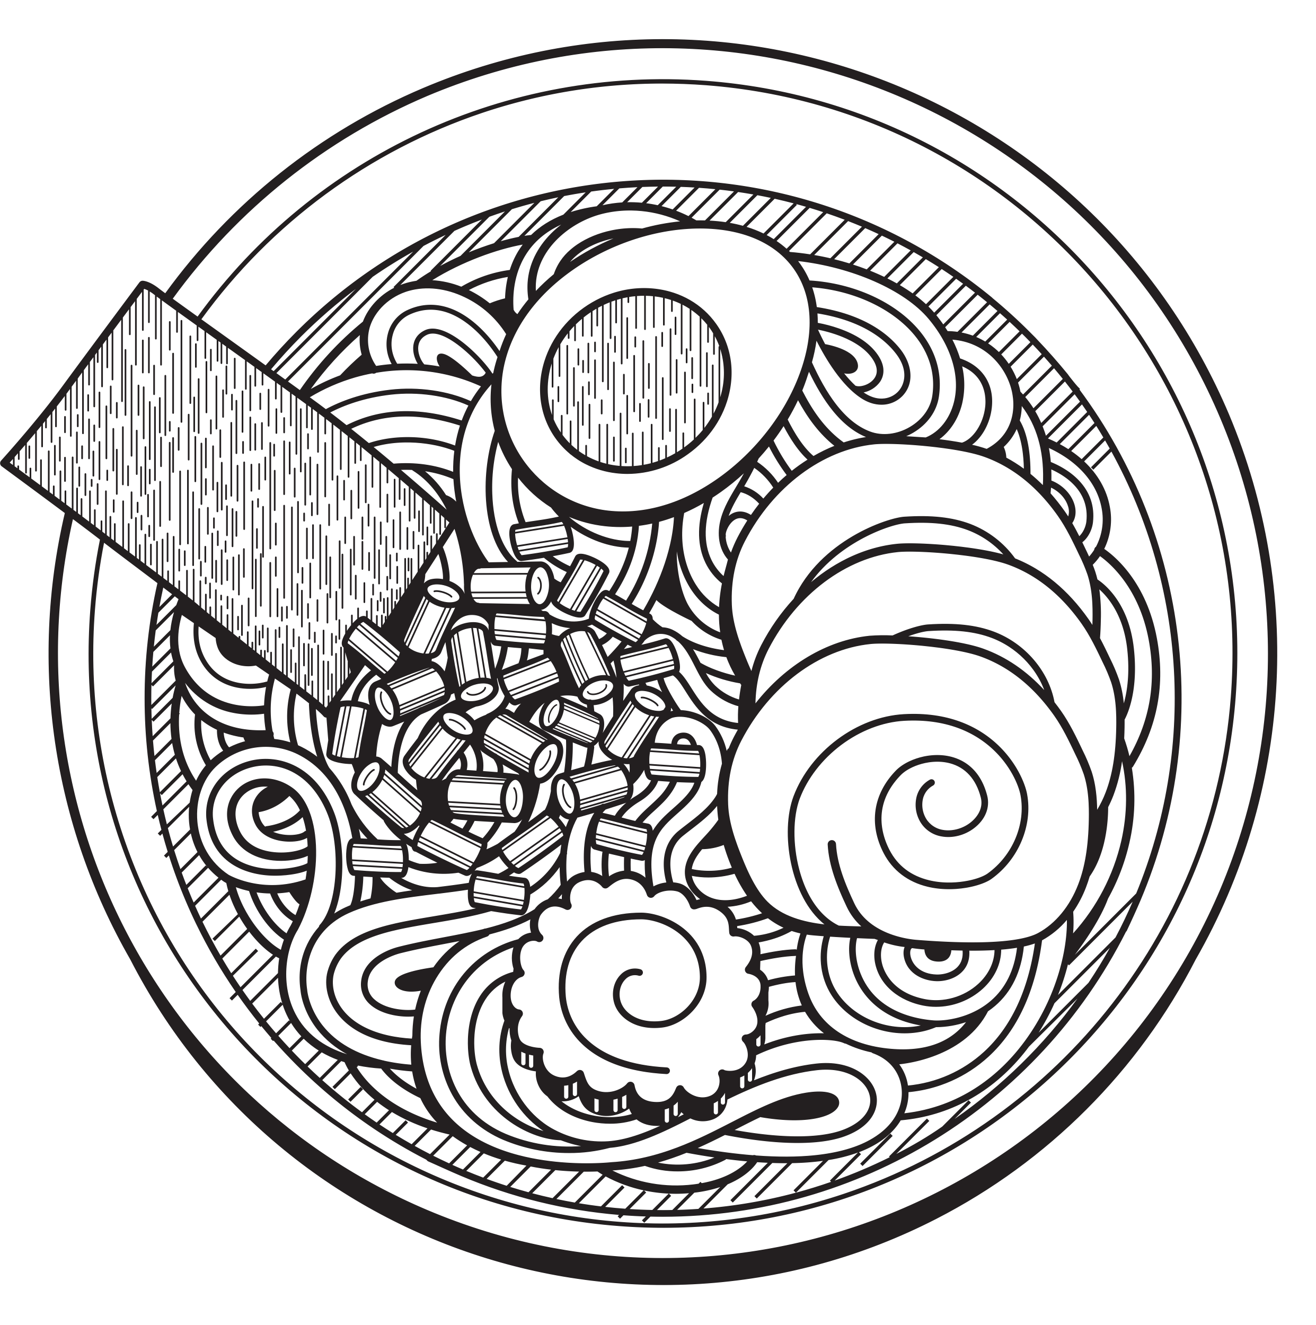
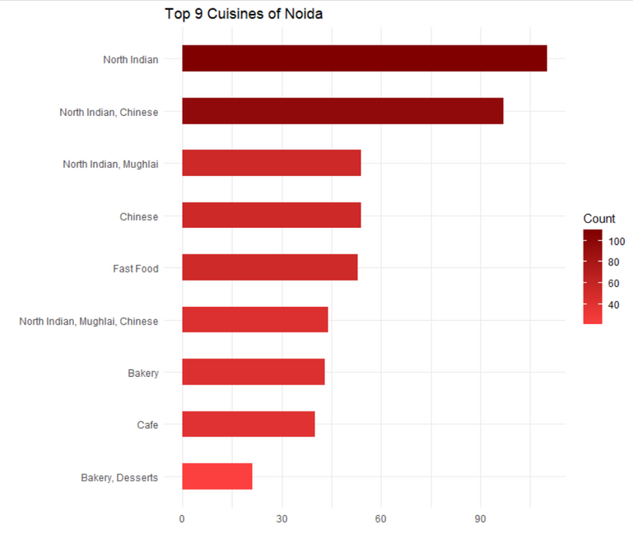
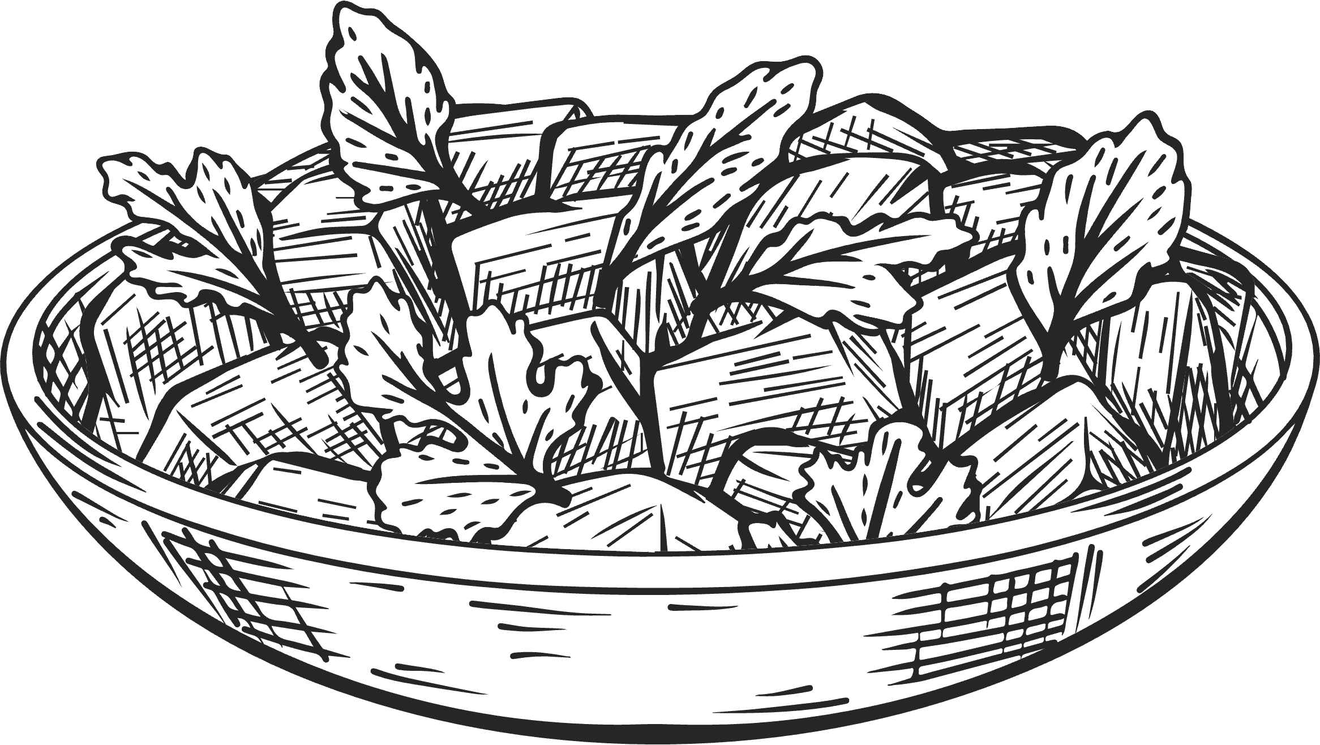
NCR Region
Whether Faridabad, Gurgaon or Noida every city likes to eat "North Indian" & "Chinese" food

Slide 16

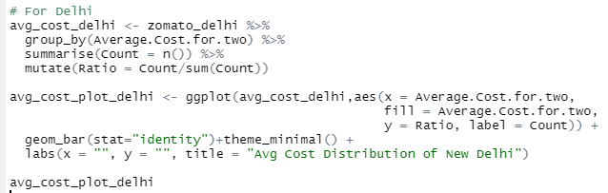
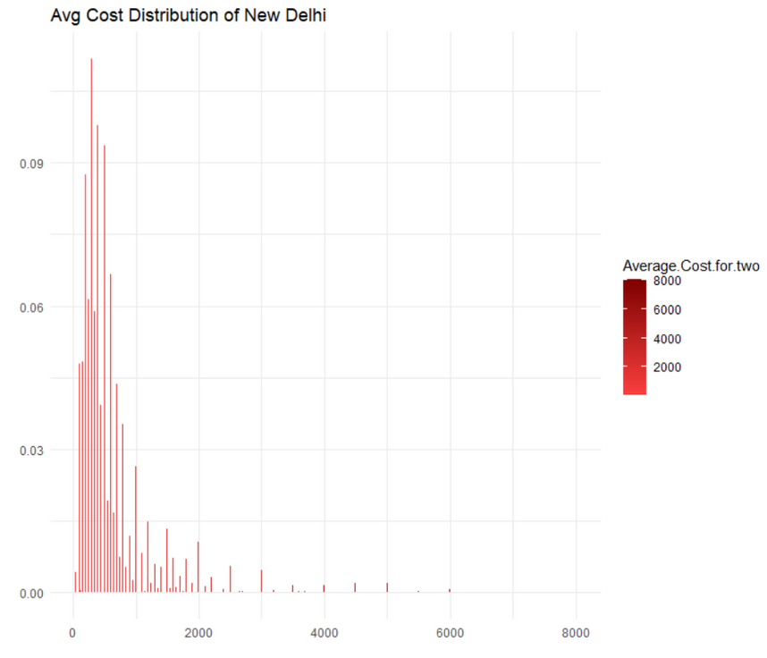
Cost for two - Delhi
Graph for number of restaurants and average cost for two is highly skewed

Slide 17
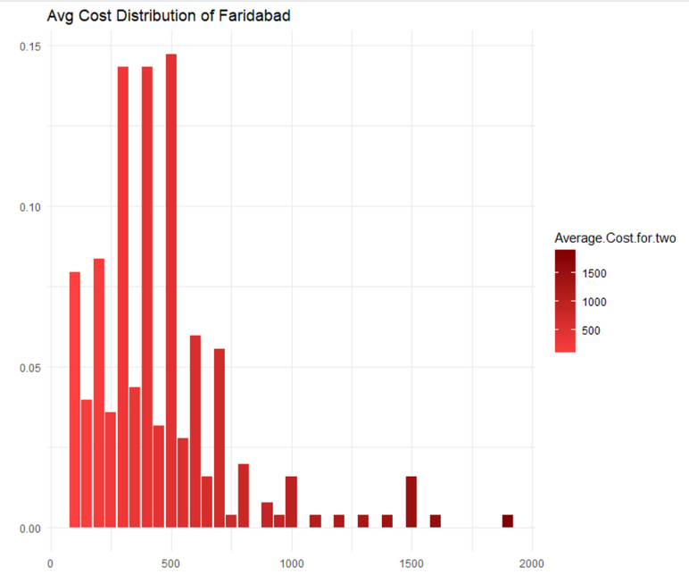
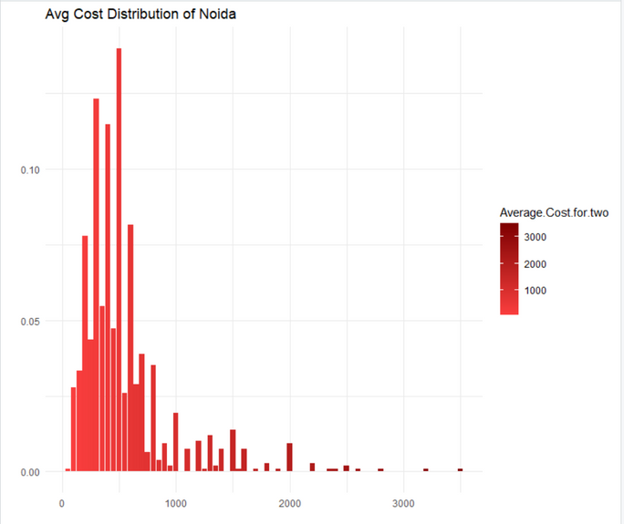
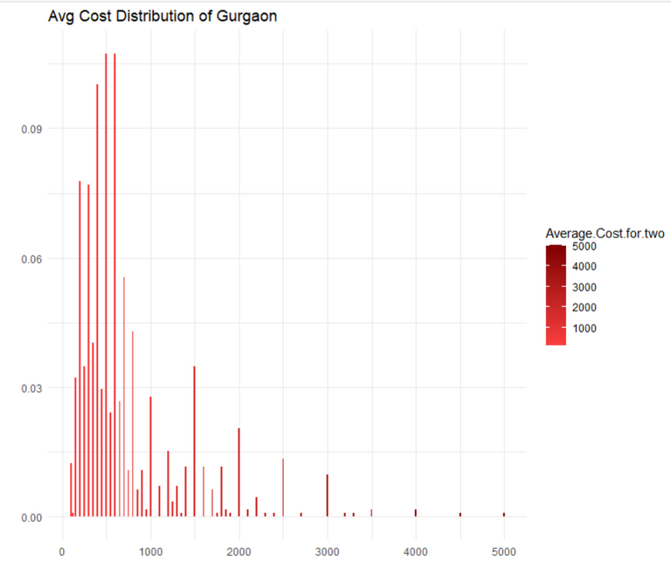
Cost of two - NCR
Distribution for Noida and Gurgaon seems right-skewed which shows that the mean is greater than the median. This can be because of the presence of outliers that are affecting the average cost for two as a whole
Distribution of ratio count and average cost is pretty random with highest ratios lying in less than 500 price range

Slide 18
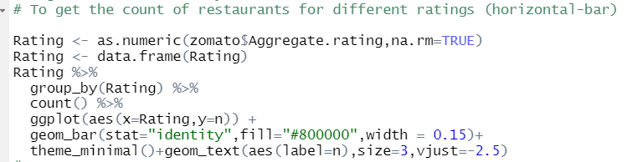
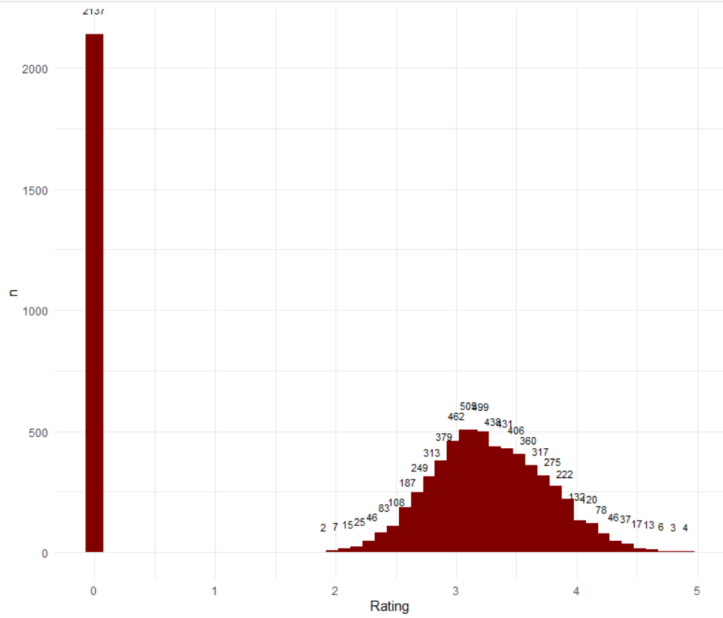
Number of Resturants based on Ratings
A lot of people (2137 in this case) do not give ratings and among those who give a normal distribution is observed with a majority restaurants rating between 2.8 to 3.8

Slide 19
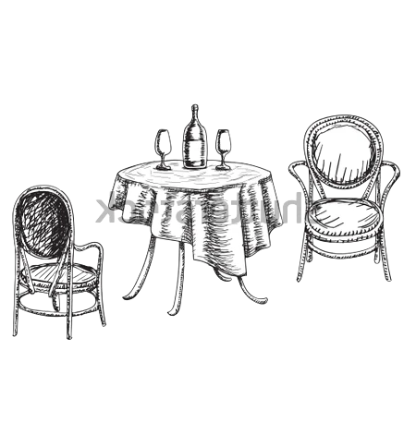
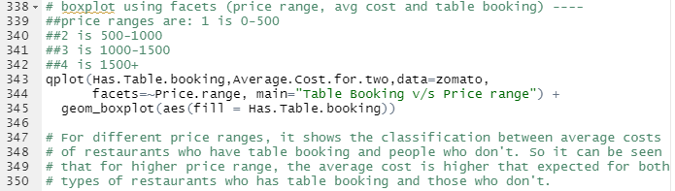
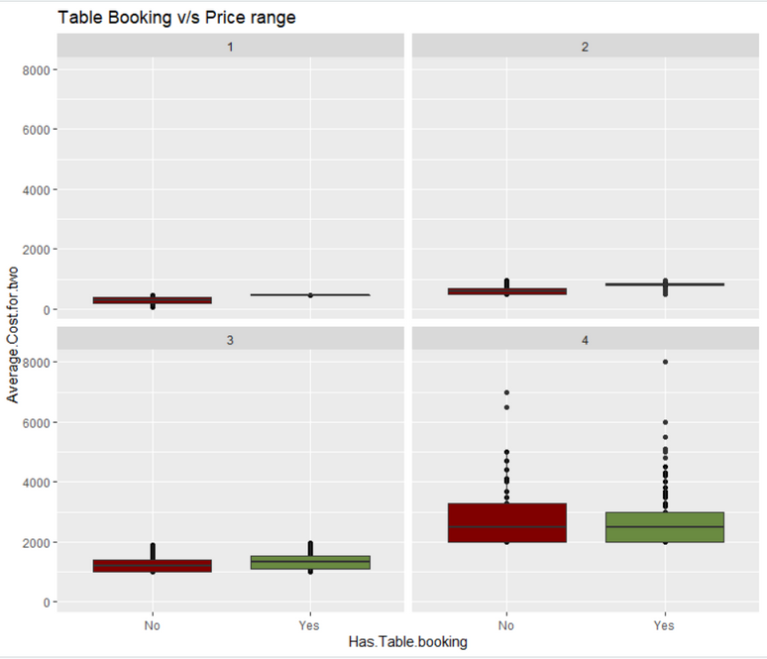
Average cost impacts Table Booking
For different price ranges, it shows the classification between the average costs of restaurants that have table booking and people who don't. So it can be seen that for a higher price range, the average cost is higher than expected for both types of restaurants who have table booking and those who don't.

Slide 20
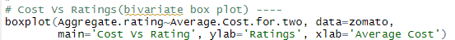
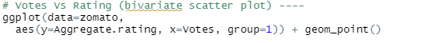
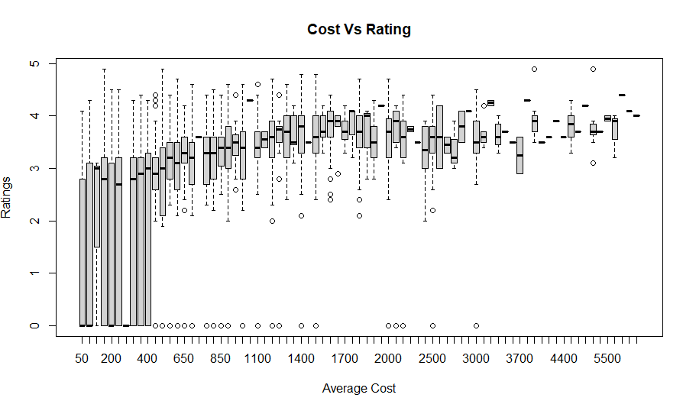

What affects a restaurant ratings?
The restaurants in price range 1 (cost < 500) have wide range of ratings when compared with the restaurants with higher price range. Though aggregate ratings are a based on sum of ratings given by a group of customers it does not increase based on the no of votes. So rating does not depend on votes and people give better rating to value for money restaurants

Slide 21



Does average cost impacts ratings ?
It is quiet evident that high average cost not necessarily results in high ratings

Slide 22


Must Eat Places in Delhi!
Based on the number of votes, “Connaught Place” is the place which you cant afford to miss in your trip to Delhi or for a fun evening

Slide 23



Summary
Data had no null values however, was biased towards 4 major cities – Delhi, Gurgaon, Noida & Faridabad
On an average the cost for two is INR 600 in these areas
Out of ~6800 restaurants, 4000+ fall in the price range of INR 1 – 500, so feeding at less cost here is not much an issue
The favorite cuisine for people is “North India” followed by “Chinese”
Most of the restaurants have an average rating of 2.8 to 3.8
Ratings does not depend on the cost i.e. it is necessary that restaurants with higher cost will have better ratings
If visiting these places “Connaught Place” is a must visit place as per peoples choice

Slide 24







Future Scope
1
2
3
Notes:
You are doing a great work. You can probably collaborate with other dine in apps, take in account dataset of of other states and even the international data. This can widen the horizon of your study and maybe you can then give a thought on creating a self help guide for tourists like us.

